Slide 1
Internet Security (CI6240)
Week 8 – Network-Based Attacks
Dr Martin Tunnicliffe
M.J.Tunnicliffe@kingston.ac.uk
Dr Eckhard Pfluegel
E.Pfluegel@kingston.ac.uk

Slide 2
Teaching Block 1
Introduction
Mathematical Primer
Classical Cryptography
Digital Symmetric Ciphers
Public Key Cryptography
(Reading Week)
Cryptographic Hash Functions
Networks and Network-Based Attacks
Firewalls
Cryptography on the Internet
In-Class Test 1
TB1 Wrap-Up

Slide 3
Upcoming Workshop Schedule
Week Beginning | Workshop Topic
26 September | Introduction to Deterlab
3 October | Mathematics
10 October | Classical Ciphers
17 October | Simplified DES
24 October | The RSA Cipher Algorithm
31 October | (Reading Week – No Workshop)
7 November | Getting Started with DeterLab
14 November | TCP Syn Flooding Experiment * (Today’s Workshop)
21 November
28 November | Permissions and Firewalls Experiment *
5 December
12 December | Prize Cryptography Competition
(DeterLab exercises in red. Portfolio exercises shown with a *)

Slide 4
Topics Covered
The Internet
  Addressing Schemes (MAC, IP and Ports)
  Transport Layer Protocols (TCP and UDP)
Network Vulnerabilities
  Why Networks are Vulnerable
  Vulnerability Scanning
Spoofing Attacks
  Session Hijacking and Man-in-the-Middle
Denial of Service Attacks

Slide 5
1.
The Internet

Slide 6
Introduction
The Internet!
  Global network of networks of interconnected computers
  Don’t confuse it with the “Web”!
For easy communication between computers
  Not initially with security in mind at all
  Internet Security was in many ways an afterthought!
Components of a network:
  Hosts Computers (including clients and servers)
  Nodes (including routers and switches)
  Links (wired and wireless)

Slide 7





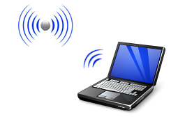
Internet Example
System 2
Server 2
System 1
WAN
System 3
LAN
Public Internet
Client A
Client D
Client B
Client C
Server 1
Server 3
Notes:
The Internet is a network “of networks”. These individual networks may use very different technlogies (Ethernet, wireless, ATM etc.) but can talk to each other by the common Internet Protocol (IP)

Slide 8
Types of Networks
Local Area Networks (LAN)
  Multiple access
  Locally controlled
  Physically protected
Wide Area Networks (WAN)
  Point-to-point links provided by ISP
  Covers significant distance
  Physically exposed
Internet
  Enormous
  Heterogeneous
  Physically and logically exposed

Slide 9
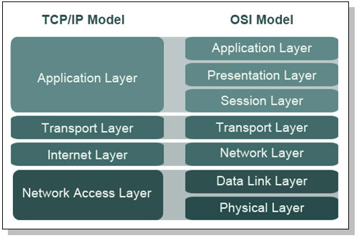
Protocol Stacks
Allow us to view network at high, abstract level of communication. Details are hidden.
Protocol Data Units (PDU’s)
Software
Message
Segment
Datagram/Packet
Frame
Hardware
4 (or 5) layers
7 layers
Notes:
Each later provides services to the layer above it, and receives services from the layer below it. It communicates with the corresponding (peer) layers on other devices.
PDU of each layer is encapsulated in PDU of the layer below. Message (or message fragment) encapsulated in a segment, encapsulated in a packet, encapsulated in a frame).
The network access layer is divided into the lower (physical) layer and the upper (link) layer. The link layer in Ethernet is further divided into the MAC layer (lower) and the LLC (upper) layer.

Slide 10
TCP/IP
“Transmission Control Protocol/Internet Protocol”
Based on 5 layers
  Layer 5 Application protocols: FTP, HTTP, SMTP
  Layer 4 – TCP/UDP. Application messages encapsulated within “segments”. End applications identified by “ports”.
  Layer 3 – Transport across Internet. Segments encapsulated in packets. End hosts identified by IP addresses
  Layer 2 – Transport within a network. Packets encapsulated in frames. Local endpoints identified by MAC addresses.
  Layer 1 - Physical layer (pulses of electricity/light)

Slide 11
Addressing Schemes
TCP/IP addressing scheme
  IP address: 32-bits indicating a host (computer or router port)
  Port number: 16-bit integer indicating application on a computer
  Example: 100.24.48.6:80 (written in decimal, 80 is port number)
  Also textual domain names (e.g. kingston.ac.uk:80).
    DNS server maps textual names to IP addresses.
MAC (Media Access Control) addressing scheme
  Unique 48 bits indicating a “host” (computer or router port).
  Example: 00-22-4D-50-60-07 (always written in hexidecimal)
  Mapped to corresponding IP addresses by Address Resolution Protocol (ARP)

Slide 12
IP Addresses and Subnetting
MAC addresses are “flat”
  Addresses are hard-wired into devices
  Address value only tells you who manufactured the device
    Nothing about what network it is connected to.
IP addresses are hierarchical
  First part indicates the network
  Second part indicates the host within the network
  Separation of two parts indicated by the “subnet mask”
    Can be written out “longhand”, e.g. 255.255.255.0
    Or “shorthand”, e.g. /24

Slide 13
IP Addresses and Subnetting
For example network 10.1.0.0/16
  The /16 is the “subnet mask”
    First 16 bits (the bytes 10 and 1) are the network address
    The remainder is used for host addresses
    Could also be written 255.255.0.0 (1=network bit, 0=host bit)
  Host addresses may be between 10.1.0.1 and 10.1.255.254
    10.1.0.0 is reserved for the address of the network itself
    10.1.255.255 is reserved for the network broadcast address
Network Address
Host Address
00001010
00000001
XXXXXXXX
XXXXXXXX
/16 bits
X=1 or 0
Notes:
10.1.0.0 has all zeros in the host part of the address. This address is the address of the network itself, and cannot be assigned to a host within the network.
10.1.255.255 has all 1’s in the host part of the address. This is the “broadcast address”. Any packet sent to this address will go to every host in the network.

Slide 14
Protocol Data Units (PDUs)
Application Data (Web, E-mail etc.)
Application Layer
(Message)
ENCAPSULATION
Transport Layer
(Segment)
Source Port
Dest. Port
Message
ENCAPSULATION
Internet Layer
(Packet/Datagram)
Source IP
Dest. IP
Segment
ENCAPSULATION
Source MAC
Dest. MAC
Packet
Network Access Layer
(Frame)
Notes:
Note that all the PDU headers really have more information in them than I have shown here. (Some also have “trailers” added after the payload field.) Also a body of application data (a document, image or web-page) would typically be split between several segments and sent out in different packets. Similarly a large packet might be split at the data link layer and sent out in several frames.

Slide 15
Routers and Switches
Router switches packet between different networks
It dismantles incoming frames and builds new outgoing frames
Switch delivers frames to the correct local host address
Frame
Packet
LAN
Network
WAN Network
Frame
Packet
Packet
Frame
Client A
LAN
Network
Client B
Client D
Client F
Client C
Server
Client E
Notes:
LAN = Local Area Network
WAN = Wide Area Network
The frames contain the MAC addresses of the Layer 3 devices they are coming from (source MAC) and destined to (destination MAC). They know nothing of the final destinations of their “passenger” packets.

Slide 16
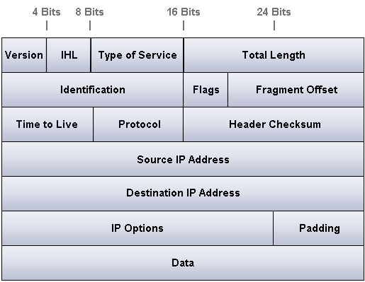
Detailed IP (v.4) Packet Structure
6 indicates a TCP segment,
17 a UDP datagram,
1 an ICMP message
TCP segment (or UDP datagram) goes in here
All of this (typically) is encapsulated into the data field of an Ethernet frame.

Slide 17
Layer 4 Protocols
TCP/IP has two Layer 4 protocols
User Datagram Protocol (UDP)
Transmission Control Protocol (TCP)
  Acknowledgment (ACK) packets are sent back by the receiver. If no ACK is received for a segment it is resent.
  It is more reliable than UDP but slower.
Notes:
UDP tends to be used in real-time applications (voice, video) while TCP is used for things like e-mail, web, FTP etc.

Slide 18
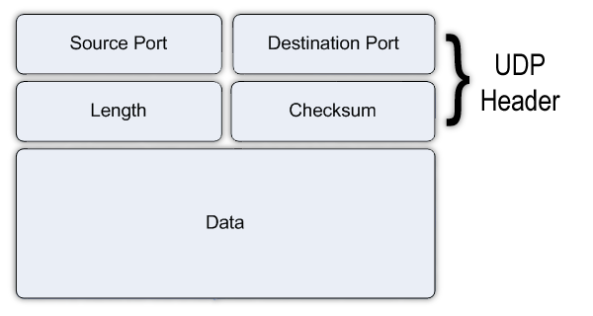
Detailed UDP Datagram Structure

Slide 19


User Datagram Protocol (UDP)
Sends the packets out without acknowledgment
It is fast but unreliable - data can go missing
No attempt to reorder data at receiver
Segment 1
Segment 2
Segment 3
Alice:
“I am sending my segments
to Bob, but have no idea if he
is receiving them”
Bob:
“I am receiving segments from Alice, but am not returning any acknowledgments to her”
Good for “timely” data (video, voice)
Poor for “accurate” data (documents, e-mails)

Slide 20

Transmission Control Protocol (TCP)
Good for when accuracy is needed and you can afford to wait.
“Connections” are negotiated between end-hosts
Starts with a “handshake”
SYN
Alice:
“Hey Bob! I want to send you some data!”
Bob:
SYN-ACK
Alice:
Bob:
“OK Alice, send away!”
Notes:
The SYN segment specifies the requested service in terms of the destination port number (e.g. 80 for a web-page request). The source port is a large random number.
The return of a SYN-ACK segment indicates that that service is available (i.e. the requested port is “open”). If no response then the requested port is “closed”.

Slide 21
Transmission Control Protocol (TCP)
ACK
Alice:
“OK Bob! Comes the data!”
Bob:
Segment 3
Segment 2
Segment 1
TCP “Connection”
ACK 1
ACK 2
ACK 3
Alice:
“I am sending packets to Bob
and if I don’t get an acknowledgment
for a packet I will resent it. I adjust my
sending rate to suit Bob.” [FLOW CONTROL]
Bob:
“I am receiving packets from Alice and acknowledging them. If any arrive out of sequence I will re-order them.”

Slide 22
Transmission Control Protocol (TCP)
FIN
Alice:
“OK Bob, that’s all the data I have!”
Bob:
ACK
FIN
Alice:
Bob:
“OK Alice, bye for now!”
Connection Ended
ACK
Alice:
“Bye!”
Bob:

Slide 23
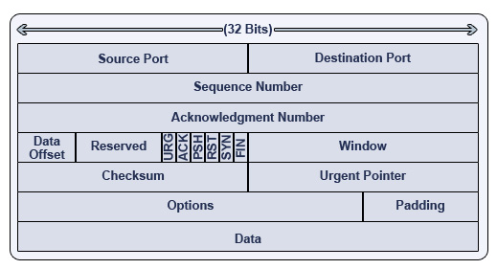
Detailed TCP Segment Structure
Remembering Flags
Unskilled = URG
Attackers = ACK
Pester = PSH
Real = RST
Security = SYN
Folks = FIN
URG (1 bit) – indicates that the Urgent pointer field is significant
ACK (1 bit) – indicates that the Acknowledgment field is significant.
PSH (1 bit) – Push function. Asks to push the buffered data to the receiving application.
RST (1 bit) – Reset the connection
SYN (1 bit) – Synchronize sequence numbers.
FIN (1 bit) – No more data from sender

Slide 24
TCP Start Handshake (Flag Operation)
SYN=1, ACK=0
Source Port: 52138
Destination Port: 80
SYN=1, ACK=1
Source Port: 80
Destination Port:52138
SYN=0, ACK=1
Source Port: 52138
Destination Port: 80
Browser
(Random Port, e.g. 52138)
Web Server (Port 80)

Slide 25
TCP Ongoing Session (Flag Operation)
SYN=0, ACK=1
Source Port: 52138
Destination Port: 80
SYN=0, ACK=1
Source Port: 80
Destination Port:52138
SYN=0, ACK=1
Source Port: 52138
Destination Port: 80
SYN=0, ACK=1
Source Port: 80
Destination Port:52138
Browser
(Random Port, e.g. 52138)
Web Server (Port 80)

Slide 26
TCP Session End (Flag Operation)
FIN=1, ACK=0
Source Port: 52138
Destination Port: 80
FIN=0, ACK=1
Source Port: 80
Destination Port:52138
FIN=1, ACK=0
Source Port: 80
Destination Port:52138
FIN=0, ACK=1
Source Port: 52138
Destination Port: 80
Browser
(Random Port, e.g. 52138)
Web Server (Port 80)

Slide 27
2.
Network Vulnerabilities

Slide 28
Types of Attack
Interception
  Packets intercepted
  CONFIDENTIALITY ISSUE
Modification Spoofing
  Packets intercepted, modified and sent on!
  INTEGRITY ISSUE
Masquerade Spoofing
  Third party makes up original message
  AUTHENTICATION ISSUE
Interruption
  Denial of Service
  AVAILABILITY ISSUE
Notes:
Network Security
18th - 22nd Feb 2008
© 2006 Kingston University - Luke Hebbes

Slide 29
What Makes a Network Vulnerable?
Anonymity – attacker can be geographically distant, identity can be hidden
Many points of attack (targets and origins) – attack can come from any host to any host
Sharing – more users and access to more systems increases security risks (e.g. cloud providers)
System Complexity – difficult to look behind scenes
Unknown Path – nature of Internet makes it impossible to predict routes
Protocol Flaws – attacks not anticipated by designers

Slide 30
Protocol Flaws
Internet protocols are publicly posted for review (RFCs – quasi-official documents from IETF).
Helps to find problems before protocol becomes standard
This does not guarantee the absence of flaws
Example:
  HTTP: Easy to intercept or fabricate headers
  SMTP: Easy to fake origin

Slide 31
Preparing an Attack
A clever attacker investigates and plans before acting
Goal: find out as much as possible about target
  Social Engineering/Reconnaissance
  Port Scanning – find out what services the target host provides
  Operating System and Application Fingerprinting
  Bulletin Boards and Chats
  Availability of Documentation

Slide 32
Vulnerability Scanning
Done by “ethical hackers” as well as real enemies
Probes for network security weak spots
Most popular technique: port scanning
Will highlight security problems of your machine/network, which can then be fixed
Attackers have access to these tools as well and can use them against you
Many tools, some run on a dedicated machine, others run over the web
Notes:
Many very powerful tools about exploit weaknesses as well as detect them. NMAP a classic example, which will crash UNIX servers.

Slide 33

Port Scanning
Reconnaissance Technique:
  Can find out what is running on system by scanning ports.
  Harry the Hacker scans port 25 (SMTP) on Bob’s PC
From:
Port: 54654
To:
Port: 25
SYN
Naughty Harry:
“Knock Knock!”
Bob:
To:
Port: 54654
RST
From:
Port: 25
Naughty Harry:
(“I see that Bob has Port 25 closed. Therefore Bob has no SMTP server running.”)
Bob:
(“Returns a RESET segment”)
Notes:
Network Security
18th - 22nd Feb 2008
© 2006 Kingston University - Luke Hebbes

Slide 34

Port Scanning
Bob now has a firewall between himself and Harry
  This firewall filters packets
  It has been configured to block anything from Harry
From:
Port: 54654
To:
Port: 25
SYN
Naughty Harry:
“Knock Knock!”
Bob:
Harry waits n seconds but no reply
To:
Port: 54654
From:
Port: 25
Naughty Harry:
(“Bob’s machine is either down, or else Port 25 is “filtered”. I cannot know if SMTP is running.)
Bob:
(Never received the SYN segment)
Notes:
Network Security
18th - 22nd Feb 2008
© 2006 Kingston University - Luke Hebbes

Slide 35
Port Scanning
From:
Port: 60113
To:
Port: 25
SYN
Naughty Harry :
“Knock Knock!”
Alice:
To:
Port: 60113
SYN-ACK
From:
Port: 25
RST
Naughty Harry:
(“Aha! Alice has Port 25 open so she is probably running an SMTP server!”)
Alice:
“Who’s there?”
Connection to Alice is still “half open”
Harry must reset connection, or else Alice may become suspicious

Slide 36
Port Scanning Tools
There are lots of online tools for port scanning
  http://www.subnetonline.com/pages/network-tools/online-port-scanner.php
  http://www.t1shopper.com/tools/port-scan/
Also download “nmap” program:
  http://nmap.org/

Slide 37
Web Log File
#Software: Microsoft Internet Information Services 7.0
#Version: 1.0
#Date: 2010-02-21 04:41:26
#Fields: date time s-ip cs-method cs-uri-stem cs-uri-query s-port cs-username c-ip cs(User-Agent) sc-status sc-substatus sc-win32-status time-taken
2010-02-21 04:41:26 192.168.16.20 GET /intl/zh-CN/ - 80 - 221.195.73.68 Mozilla/4.0+(compatible;+MSIE+6.0;+Windows+NT+5.1) 404 0 64 562
2010-02-21 06:02:58 192.168.16.20 GET /fastenv - 80 - 221.195.73.68 Mozilla/4.0+(compatible;+MSIE+6.0;+Windows+NT+5.1) 404 0 64 578
2010-02-21 11:24:06 192.168.16.20 GET /cgi-bin/textenv.pl - 80 - 221.195.73.68 Mozilla/4.0+(compatible;+MSIE+6.0;+Windows+NT+5.1) 404 0 64 671
...
2010-02-21 11:33:31 192.168.16.20 GET /manager/html - 80 - 221.6.38.203 Mozilla/3.0+(compatible;+Indy+Library) 404 0 2 484
2010-02-21 15:27:10 192.168.16.20 GET /prx2.php - 80 - 61.183.15.9 Mozilla/4.0+(compatible;+MSIE+6.0;+Windows+NT+5.0) 404 0 2 1359
2010-02-21 19:01:07 192.168.16.20 GET /sumthin - 80 - 209.88.88.251 - 404 0 64 3828
2010-02-21 20:34:43 192.168.16.20 GET /prx2.php - 80 - 61.183.15.9 Mozilla/4.0+(compatible;+MSIE+6.0;+Windows+NT+5.0) 404 0 2 1625
2010-02-21 21:48:17 192.168.16.20 GET /phpmyadmin/config/config.inc.php p=phpinfo(); 80 - 192.146.134.251 Mozilla/4.0+(compatible;+MSIE+6.0;+Windows+98) 404 0 2 640
2010-02-21 21:48:17 192.168.16.20 GET /pma/config/config.inc.php p=phpinfo(); 80 - 192.146.134.251 Mozilla/4.0+(compatible;+MSIE+6.0;+Windows+98) 404 0 2 140
2010-02-21 21:48:17 192.168.16.20 GET /admin/config/config.inc.php p=phpinfo(); 80 - 192.146.134.251 Mozilla/4.0+(compatible;+MSIE+6.0;+Windows+98) 404 0 2 140
...
Reverse-DNS: linserv.abc.hu - in Hungary
Notes:
Network Security
18th - 22nd Feb 2008
© 2006 Kingston University - Luke Hebbes

Slide 38
linserv.abc.hu Port Scan
Nmap scan report for linserv.abc.hu (192.146.134.251)
Host is up (0.020s latency).
Not shown: 968 closed ports
PORT STATE SERVICE VERSION
1/tcp open tcpwrapped
21/tcp filtered ftp
22/tcp open tcpwrapped
23/tcp open telnet?
25/tcp filtered smtp
43/tcp filtered whois
53/tcp open domain?
79/tcp open tcpwrapped
110/tcp open pop3?
111/tcp filtered rpcbind
113/tcp open auth?
119/tcp open tcpwrapped
139/tcp filtered netbios-ssn
143/tcp open imap?
179/tcp filtered bgp
445/tcp filtered microsoft-ds
515/tcp filtered printer
1080/tcp open tcpwrapped
1433/tcp filtered ms-sql-s
1524/tcp open tcpwrapped
2000/tcp open tcpwrapped
4662/tcp filtered edonkey
6346/tcp filtered gnutella
6667/tcp open tcpwrapped
|_irc-info: Unable to open connection
6699/tcp filtered napster
8080/tcp open tcpwrapped
12345/tcp open tcpwrapped
31337/tcp open tcpwrapped
32771/tcp open tcpwrapped
32772/tcp open tcpwrapped
32773/tcp open tcpwrapped
32774/tcp open tcpwrapped
Nmap done: 1 IP address (1 host up) scanned in 222.13 seconds
Open Ports Identify Applications Some applications may have known vulnerabilities!
Notes:
Network Security
18th - 22nd Feb 2008
© 2006 Kingston University - Luke Hebbes

Slide 39
3.
Spoofing Attacks

Slide 40
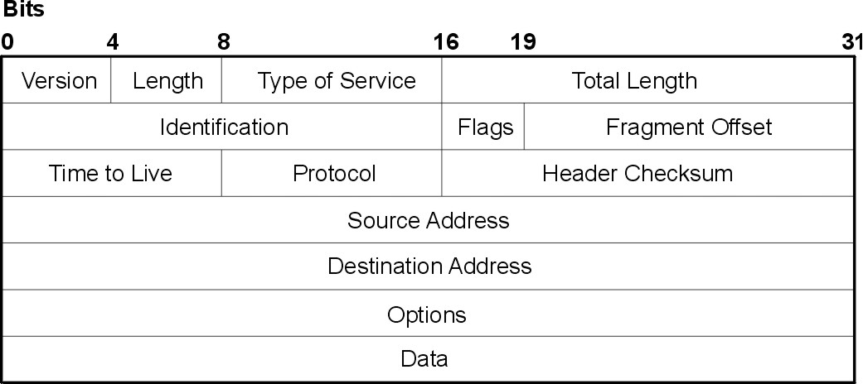
Spoofing
Bogus endpoint in a network communication
Source endpoint identified by Source IP address in packet header.
CHANGED BY ATTACKER

Slide 41
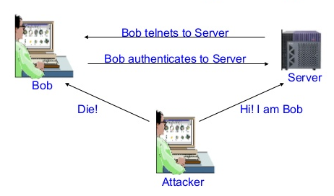
Session Hijacking
Intercepting and carrying on a TCP session
Example: Telnet session (communication between hosts by a “dumb terminal” emulation)

Slide 42
Spoofing (cont.)
Man-in-the-Middle Attack:
  Similar to Session Hijacking
  Difference: participate from start of the session
  Example: symmetric key exchange
Man-in-the-Middle
Alice, it’s Bob. Please give me your key
Alice, it’s Bob. Please give me your key
Here is my key!
Bob
Alice

Slide 43
4.
Denial of Service Attacks

Slide 44
Denial of Service
So far: attacks on confidentiality or integrity
Denial of Service (DoS) attack targets availability
Does not (usually) do permanent damage – normality is restored when attack stops
Simplest method: Connection Flooding
  Attacker sends more packets than the target system can handle
  Congestion makes system unavailable to its intended users
Notes:
Network Security
18th - 22nd Feb 2008
© 2006 Kingston University - Luke Hebbes

Slide 45
Denial of Service
More sophisticated methods manipulate protocols
  “Ping of Death” – a malformed “ping” packet can be used to make the target system crash.
  Smurf – Attacker sends IMCP message all hosts on a subnet using a broadcast address, with victim’s spoofed IP address as source. They then all reply the target host.
  Syn Flood – Attacker sends many Syn packets to victim to create half-open connections, thus depleting resources
More sophisticated still: Distributed DoS attack makes use of malware agents across a “botnet” of compromised computers
Notes:
We’ll cover each of these in turn.
Network Security
18th - 22nd Feb 2008
© 2006 Kingston University - Luke Hebbes

Slide 46
“Ping of Death”
“Ping” packets use Internet Control Message Protocol (ICMP) to get an “echo reply” from another host
  Usually to check connectivity
Ping packets are normally 84 bytes long
An IPv4 packet can be as long as 65,535 bytes
  This would be fragmented into many frames by Ethernet
So attacker sends a ping packet > 65,545 bytes
  This overflows the memory buffer available for it, overwriting important data and causing system to crash.
Notes:
This is an example of something more general which we’ll consider later in the module, namely a “buffer overflow attack”.

Slide 47




Smurf Attack Illustration
INTERNET CONTROL MESSAGE PROTOCOL (ICMP) USED FOR CONTROL MESSAGES (LIKE “PING”)
10.1.0.3
10.1.0.4
10.1.0.5
Other services
Internet
10.1.0.0/16
ICMP Packet
Source IP: 10.2.12.12
Dest. IP: 10.0.255.255
(Spoofed address of target and broadcast address of this subnet)
10.1.1.2
10.1.0.20
Target Host
10.2.12.12

Slide 48
Smurf Attack Illustration
THIS CAN BE SEEN AS A COMBINED OF A SPOOF AND DoS ATTACK
10.1.0.3
10.1.0.4
10.1.0.5
Other services
Internet
10.1.0.0/16
ICMP “replies” from all hosts in subnet go to target)
10.1.1.2
10.1.0.20
Target Host
10.2.12.12

Slide 49
Syn Flood Illustration
Requests TCP connection
Allocates memory resources for new connection
SYN
Source Port: 35743
Destination Port: 80
SYN-ACK
Source Port: 80
Destination Port: 35743
Ignores
CONNECTION “HALF OPEN”
Attacking Host
(Port 35743)
Victim Host (Port 80)

Slide 50
Syn Flood Illustration
Flood of bogus connection requests
Lots of memory tied up supporting half-open connections
Responses all Ignored
Attacking Host
(Different random ports)
Victim Host (Port 80)

Slide 51
Distributed Denial of Service (DDoS)
Attacker deploys agent software units (zombies) on many remote machines
  This is usually done by means of “Trojans” – these (and other malware types) will be covered in TB2.
Attacker sends a “trigger” signal to his “zombie botnet”.
Zombies send attack packets to target system (s)
  DDoS traffic is not noticed by owners of individual infected systems
  Aggregate DDoS traffic is devastating for victim system!
Notes:
Network Security
18th - 22nd Feb 2008
© 2006 Kingston University - Luke Hebbes

Slide 52






DDoS Attack
Legitimate Traffic
500Mbit/s
Only about 1 in every 20 packets gets through
Legitimate User
DDoS Attacker
DDoS Victim (Processes 1Gbit/s)
10 Gbit/s attack traffic
Deployed Zombie Botnet
“Bottleneck”

Slide 53
Summary
The Internet
  Addressing Schemes (MAC, IP and Ports)
  Transport Layer Protocols (TCP and UDP)
Network Vulnerabilities
  Why Networks are Vulnerable
  Vulnerability Scanning
Spoofing Attacks
  Session Hijacking and Man-in-the-Middle
Denial of Service Attacks

Slide 54
Homework
Next week we will start to consider an important kind of control: the “firewall”
Watch the following YouTube videos:
  https://www.youtube.com/watch?v=z39_6XOB6wY
  https://www.youtube.com/watch?v=_FZwVhPW_5Y

